Slide 1
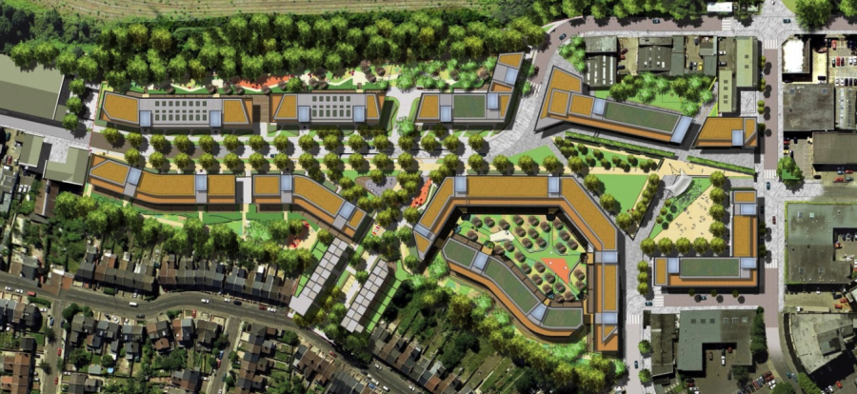
PLANNING OF A HOUSING SCHEME
STEPS INVOLVED

Slide 2
INTRODUCTION
Lahore has been placed at 42 number in the most populated urban areas in the world.
Lahore has expanded almost double area-wise in the last 12 to 14 years.
There are about 260 approved private housing schemes in Lahore developed by LDA and private developers.
Every designer has it own technique to draw a layout for a housing scheme however there are always some step in chronological order to for any task to save time and produce efficiency.

Slide 3
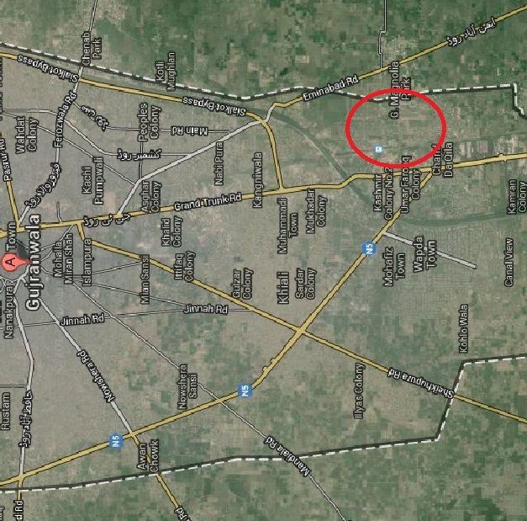
AREA TO BE ACQUIRED
STEP-1
GUJRAWALA CITY

Slide 4
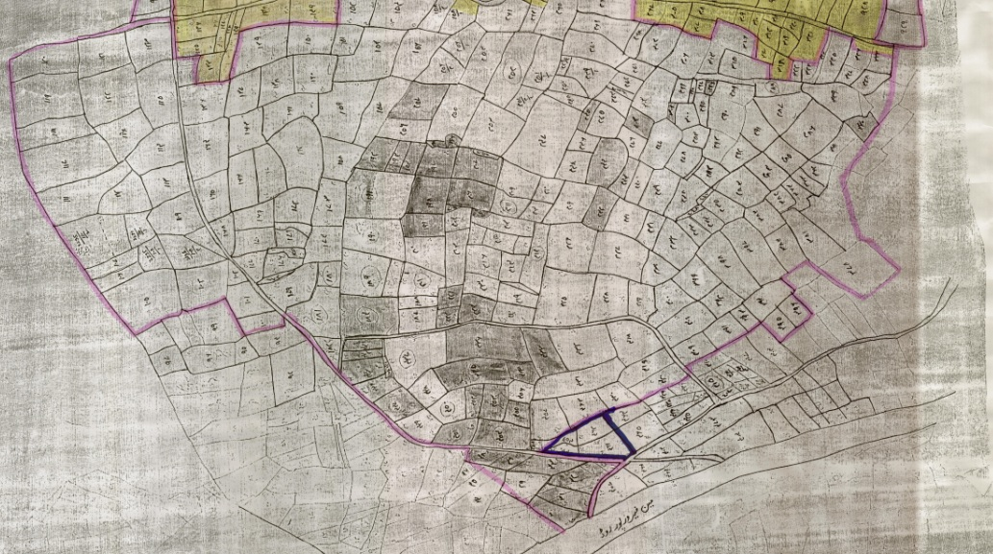
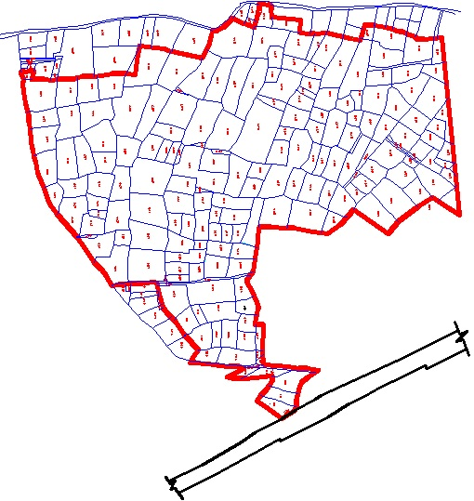
ACQUIREING KHASRA PLAN
STEP-2
Draw a boundary on khasra plan and include all the land you want to acquire for project.
Digitize khasra plan in order to calculate tentative area.

Slide 5
TYPES OF KHASRA PLAN
STEP-2 Cont…
Istemal Shuda
No fix size of individual khasra
Digitization gives an idea of area

Slide 6
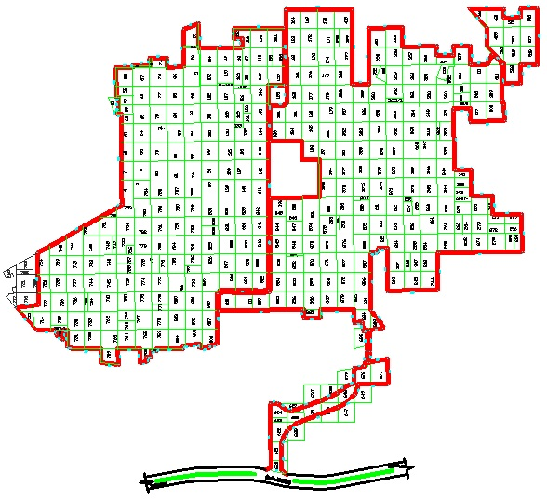
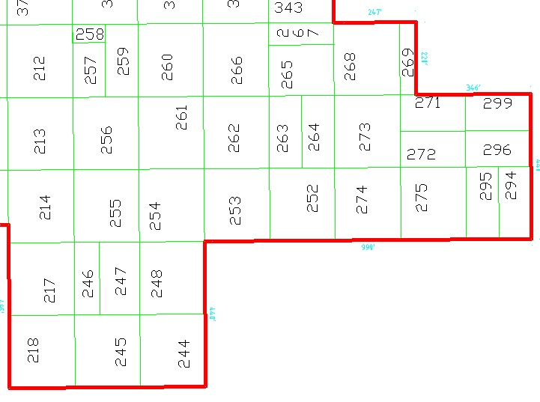
TYPES OF KHASRA PLAN (Cont…)
STEP-2 Cont…
2. Kishtwar
Proper Muraba Bandi
Regular Size Khasra (one acre)

Slide 7
MAKING OF BOUNDARY FROM KHASRA PLAN
STEP-3 Cont…

Slide 8
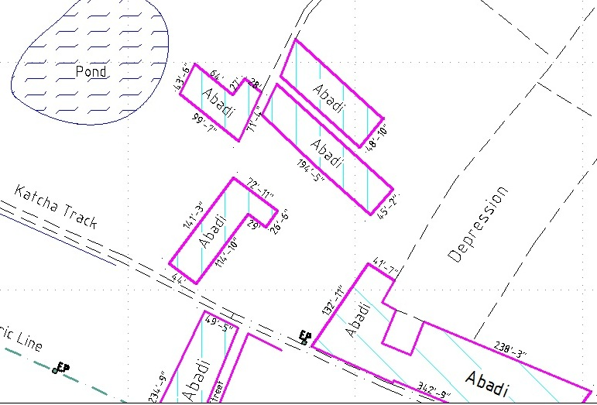
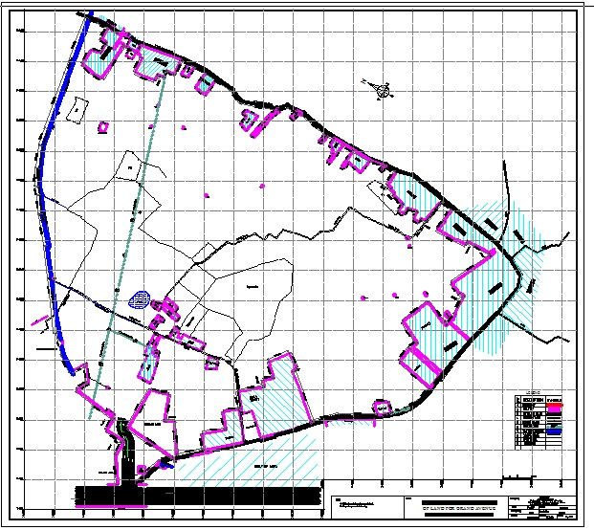
SURVEY PLAN
STEP-4
Survey Plan shows the area and dimensions of a property. It include the observations made by the surveyor to define the property boundaries (any additional information).

Slide 9
SURVEY PLAN (Cont…)
STEP-4 Cont…

Slide 10
TOPOGRAPHIC SURVEY
STEP-5
Three-dimensional characteristics of earth's surface.
In plain areas, normally grids have been created within the boundary at regular intervals. Each grid contains an elevation.
For plain area survey, grid interval can be increased.
It helps to design the layout and location of buildings, roads, dams, pipelines, landscapes, fire control routes, etc.

Slide 11
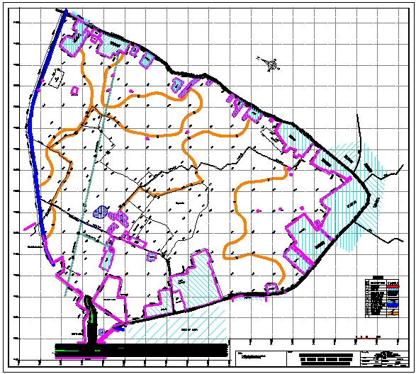
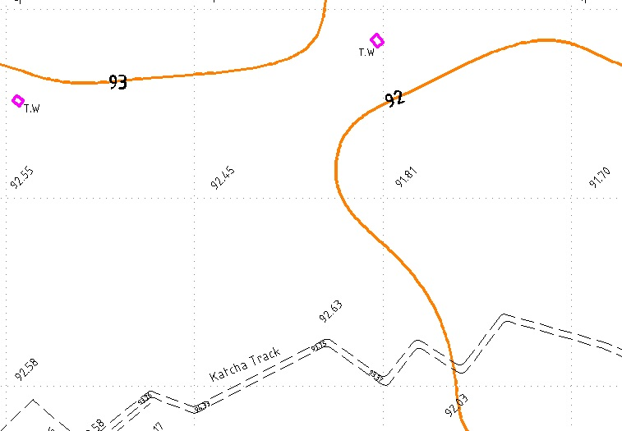
TOPOGRAPHIC SURVEY (Cont…)
STEP-5 Cont…

Slide 12
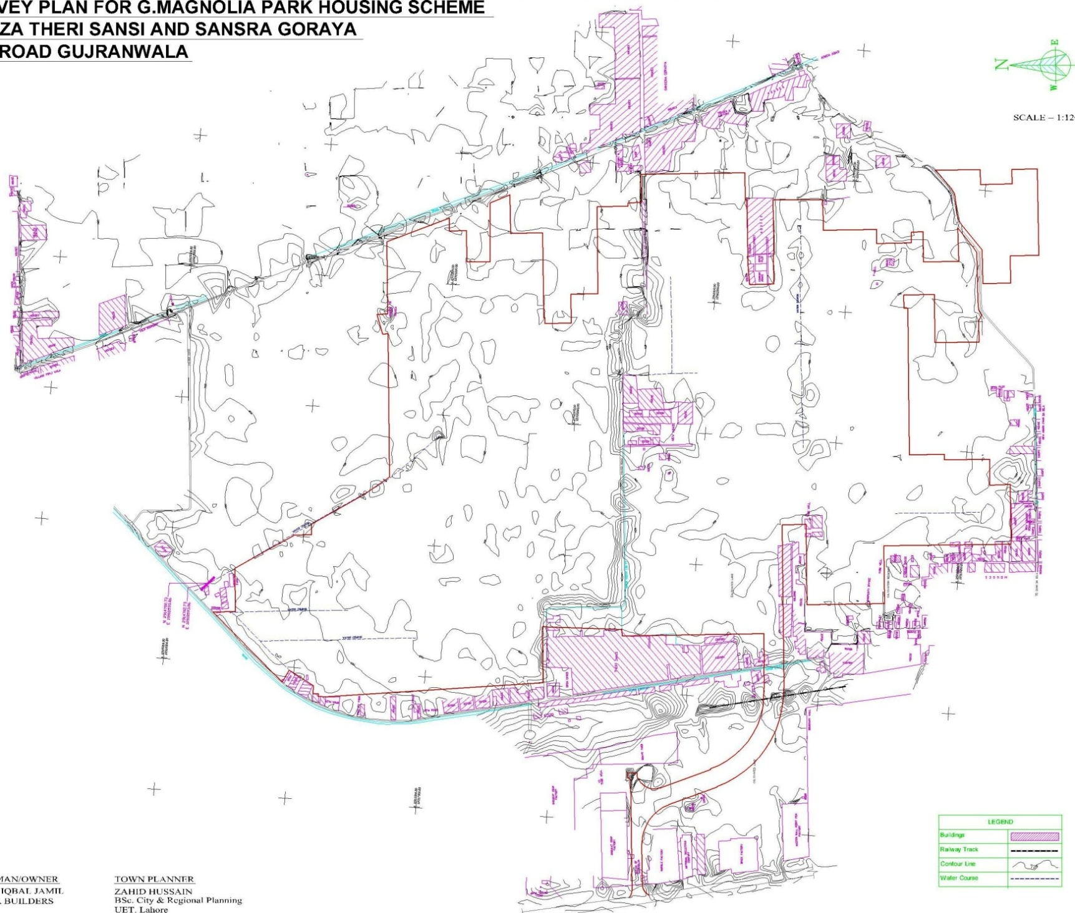
TOPOGRAPHIC SURVEY (Cont…)
STEP-5 Cont…

Slide 13
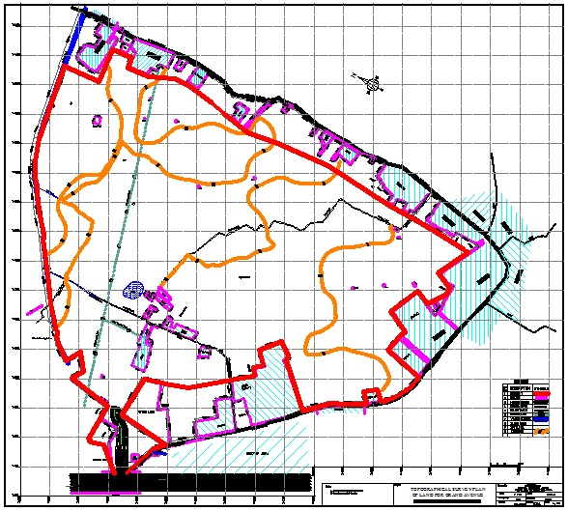
FINALIZING THE BOUNDARY
STEP-6
Keep in view existing features.
Avoid features that can not be removed or are very costly if they are to be removed.

Slide 14
FINALIZING THE BOUNDARY (Cont…)
STEP-6
Cont…

Slide 15
PRE CONSIDERATIONS
STEP-7
Try to produce a best lay out pattern.
Is there any scope of future extension of project?
Before you draw a layout plan always keep in mind whether there is any existing drain/ Nala or Trunk Sewer or Not?
Where will be the sewerage disposal station?
Is there any structure road passing through the boundary, provided in the structure plan?
Try to use existing landscape/plantation in your planning (Palm City, G.Magnolia).

Slide 16
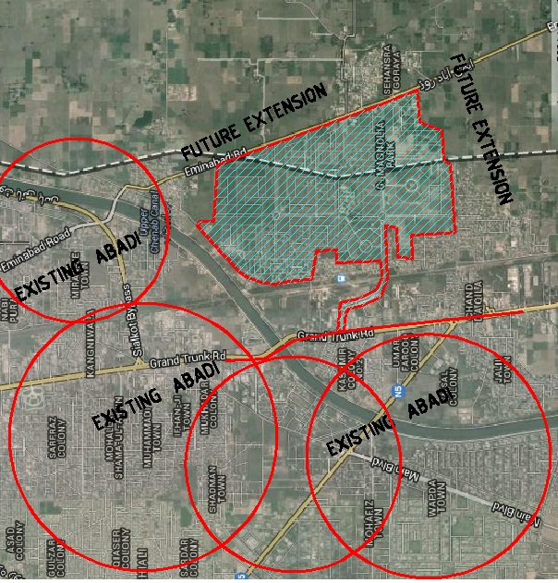
PRE CONSIDERATIONS (Cont…)
STEP-7
Cont…
Future extension.
Existing drain.
Sewerage disposal station.
Structure Road.
Existing Landscape.
GUJRAWALA CITY

Slide 17
MAKING LAYOUT
STEP-8
Produce a best layout pattern (Grid pattern, Fused Grid and Cul-de-sac layout pattern, Turbine pattern etc).
Marking of centre lines keeping in view the existing structures.
It will divide area into blocks/ neighborhoods.
Try to avoid irregular junctions especially at major roads.
Decide a sufficient ROW for major roads considering future extension of area.

Slide 18
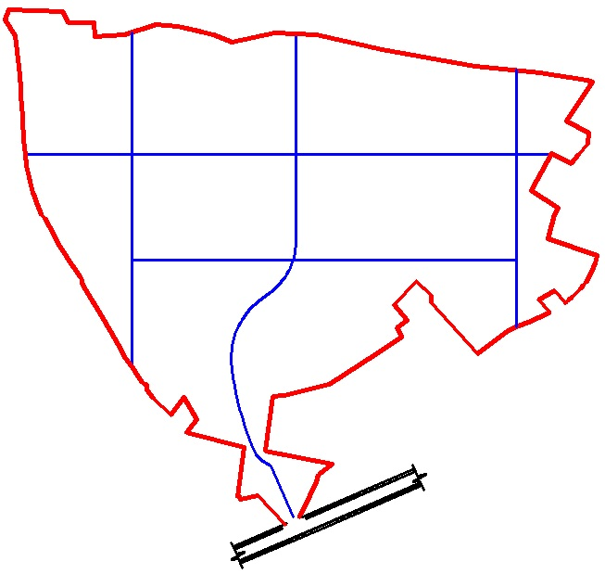
STEP-8 Cont…
MARKING CENTRE LINES

Slide 19
STEP-8 Cont…
MARKING CENTRE LINES (Cont…)

Slide 20
STEP-8 Cont…
MARKING CENTRE LINES (Cont…)
FUTURE EXTENSION
FUTURE EXTENSION
FUTURE EXTENSION

Slide 21
STEP-8 Cont…
MARKING CENTRE LINES (Cont…)

Slide 22
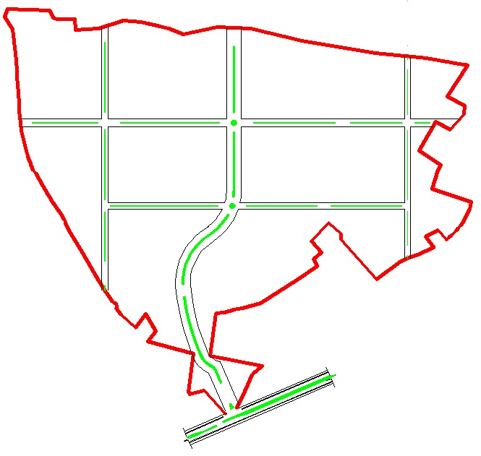
STEP-9
ASSIGNING ROW

Slide 23
STEP-9 Cont…
ASSIGNING ROW (Cont…)
UNIVERSITY TOWN
41 ACRE
50 ACRE
75 ACRE
45 ACRE
41 ACRE
46 ACRE
43 ACRE
41 ACRE
45 ACRE
47 ACRE
45 ACRE
51 ACRE
45 ACRE

Slide 24
STEP-9 Cont…
ASSIGNING ROW (Cont…)
Future
Extension?

Slide 25
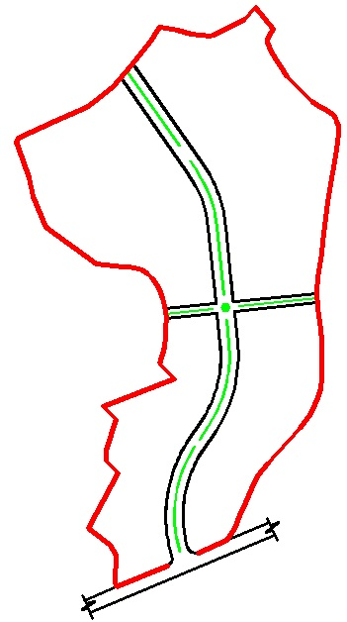
STEP-9 Cont…
ASSIGNING ROW (Cont…)

Slide 26
BASIC FACILITIES
STEP-9
Recreational Area
Park
Play Ground/Stadium (football/hockey and cricket)
Sport Complex
Cinema Hall
Health
Hospital
Clinic
Dispensary
Educational Facilities
School
College
Library

Slide 27
BASIC FACILITIES (Cont…)
STEP-9 Cont…
Shopping
Main civic centre
Sector shops at walking distance in each neighborhood.
Public Places
Jamia mosque
Neighborhood mosques
Offices (Post Office, management or maintenance office).
Community centre
Graveyard.
Security office etc.

Slide 28
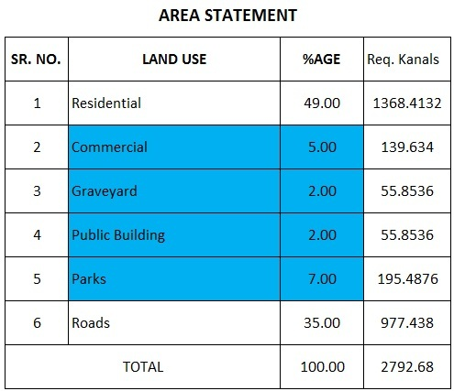
AREA CALCULATIONS
STEP-10

Slide 29
NO. OF PLOTS REQUIRED
STEP-11

Slide 30
LAND USE DISTRIBUTION AND NEIGHBORHOOD PLANNING
STEP-12
Distribution of major land uses within the boundary.
Locate main commercial centre at an appropriate location.
Consider walking distance rule.
Easily accessible to all residents.
Comfortable walking distance is about 2000 ft. (Dittmar, H., and G. Ohland, eds. The New Transit Town: Best Practices in Transit Oriented Development. 2004. Island Press. Washington, D.C. p. 120.)

Slide 31
LAND USE DISTRIBUTION AND NEIGHBORHOOD PLANNING (Cont…)
STEP-12 Cont…
Building by-laws must be in your mind.
Plots statement should also be in mind.
Consider town planning principles.
Beauty
Health
Convenience,
Safety, etc.
Self sufficient planning.

Slide 32
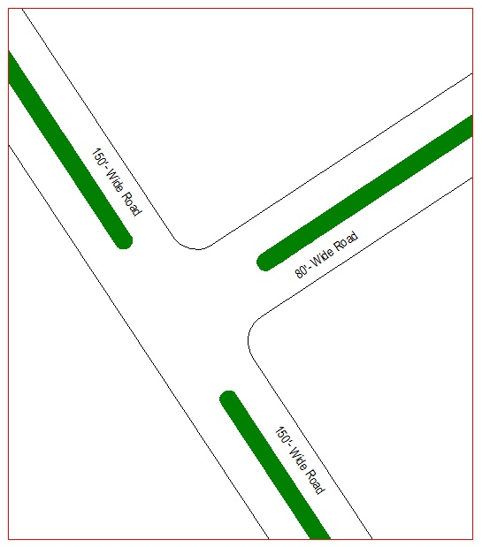
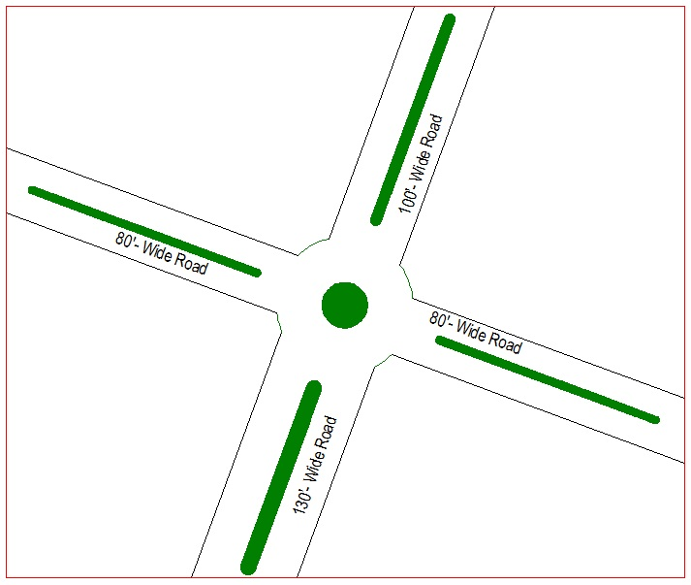
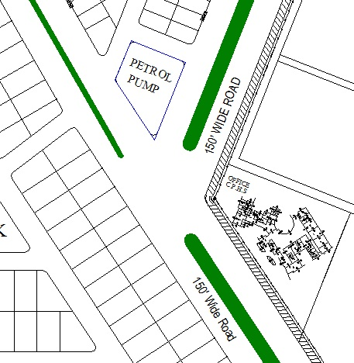
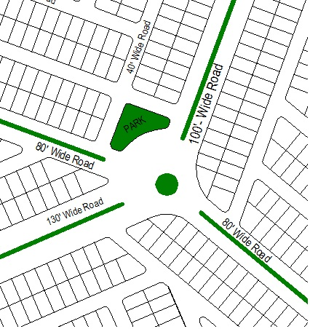
IMPORTANT CONSIDERATIONS
STEP-12 Cont…
Try to avoid odd Junctions especially at main roads.
T-JUNCTION
ROUND ABOUT

Slide 33
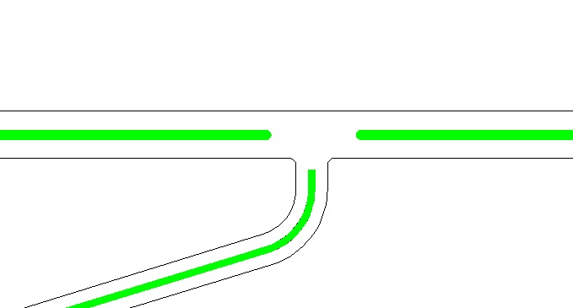
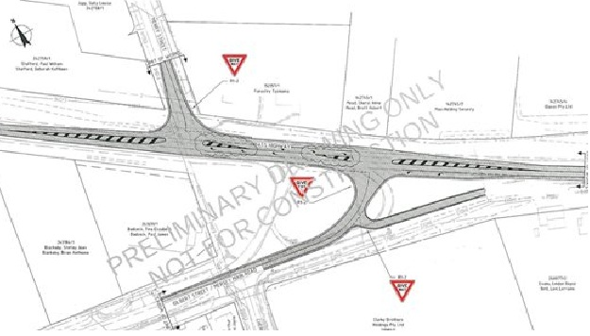
STEP-12 Cont…
IMPORTANT CONSIDERATIONS (Cont…)

Slide 34
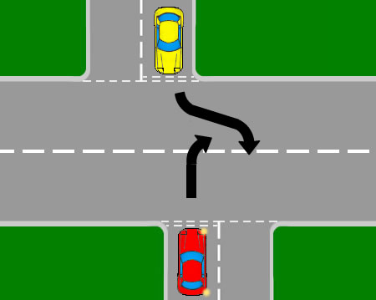
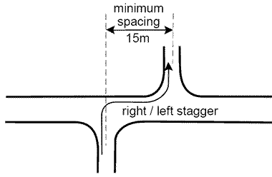
STEP-12 Cont…
IMPORTANT CONSIDERATIONS (Cont…)
?
Staggered Junction

Slide 35
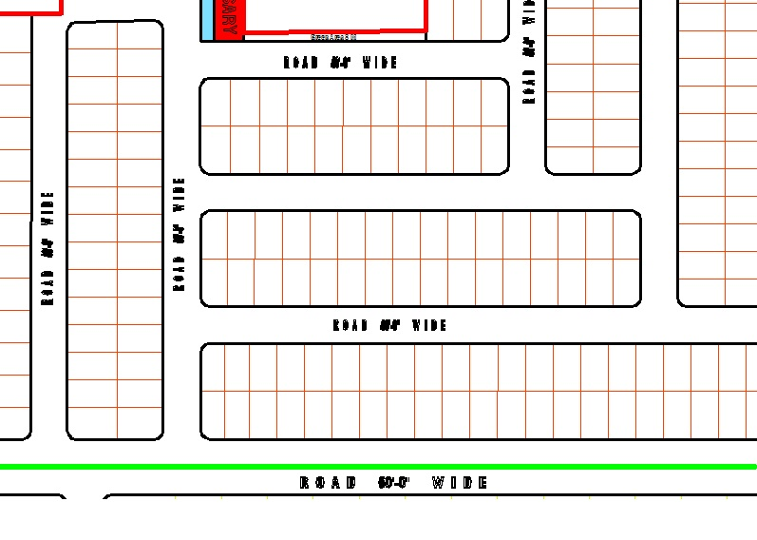
STEP-12 Cont…
IMPORTANT CONSIDERATIONS (Cont…)
Avoid too many cross and odd junctions. T-Junctions are preferred in neighborhoods

Slide 36
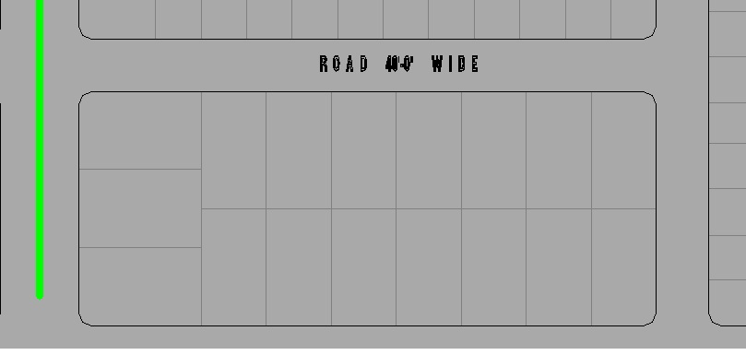
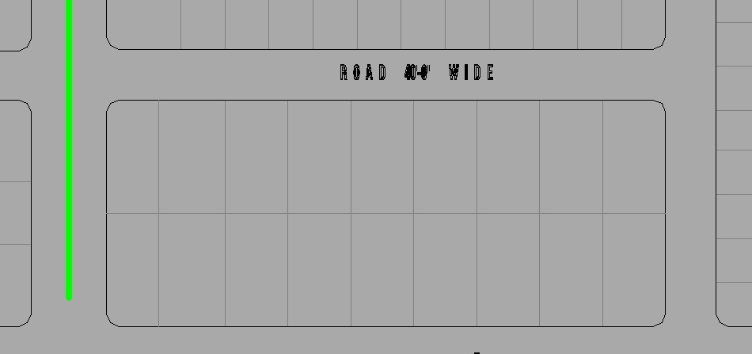
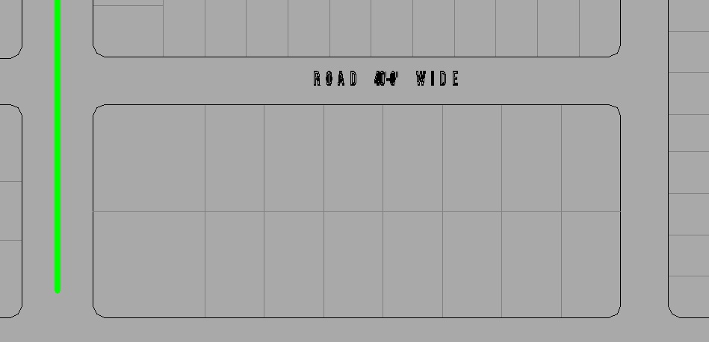
STEP-12 Cont…
IMPORTANT CONSIDERATIONS (Cont…)
Changing orientation of plots.

Slide 37
STEP-12 Cont…
IMPORTANT CONSIDERATIONS (Cont…)
Pairing is important.

Slide 38
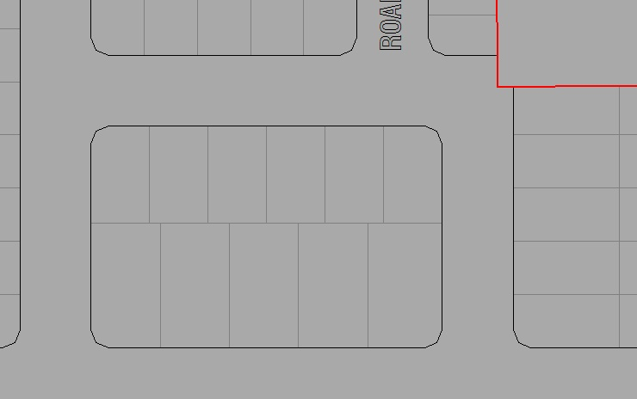
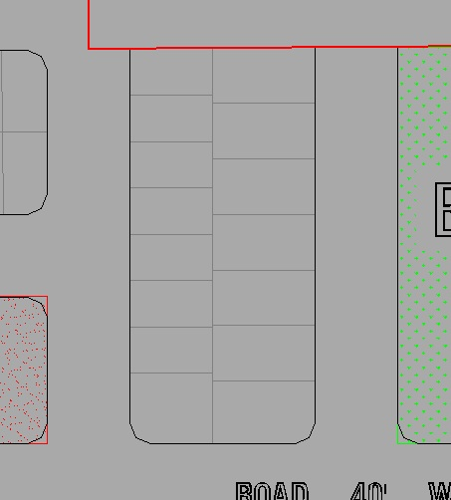
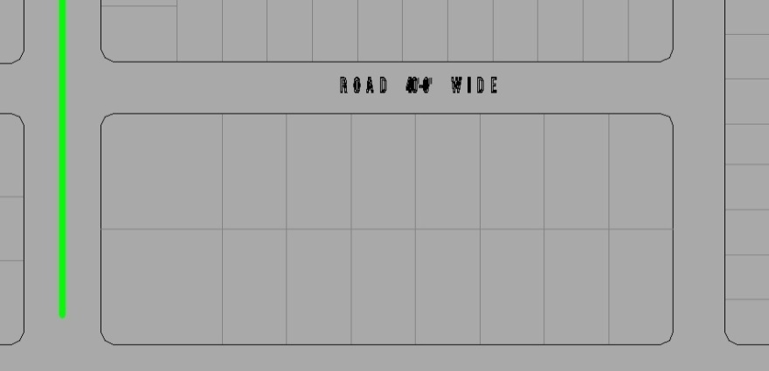
STEP-12 Cont…
IMPORTANT CONSIDERATIONS (Cont…)
Alignment

Slide 39
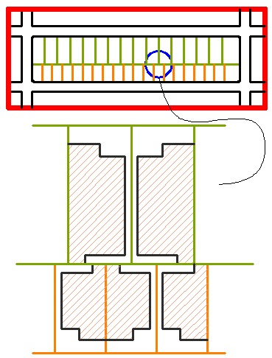
STEP-12 Cont…
IMPORTANT CONSIDERATIONS (Cont…)
Alignment

Slide 40
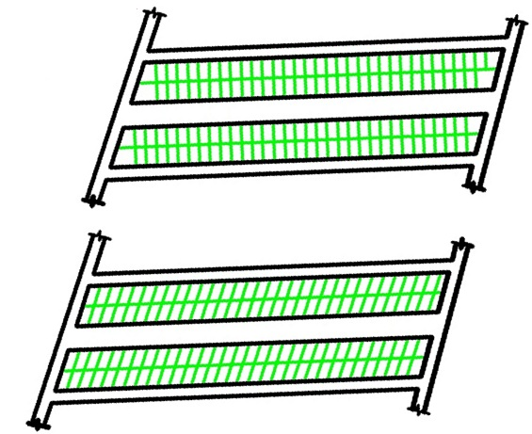
STEP-12 Cont…
IMPORTANT CONSIDERATIONS (Cont…)
Front should be at 90 angle to road.

Slide 41
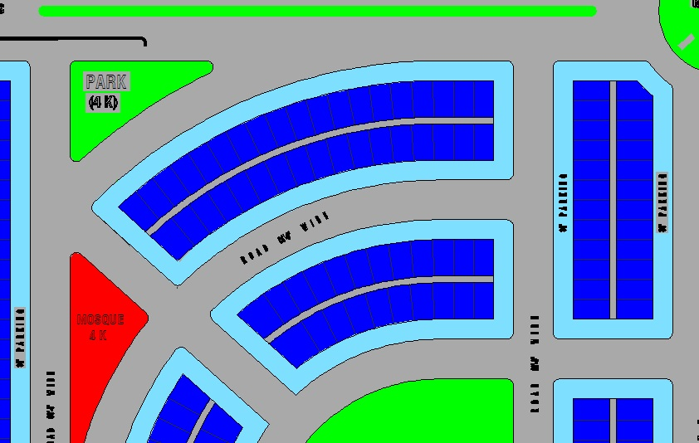
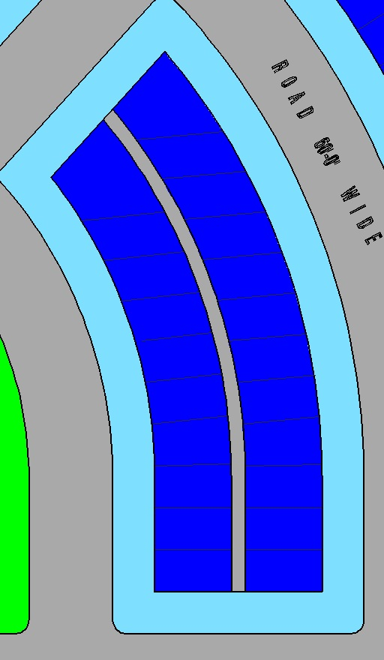
STEP-12 Cont…
IMPORTANT CONSIDERATIONS (Cont…)
Front should be at 90 angle to road.

Slide 42
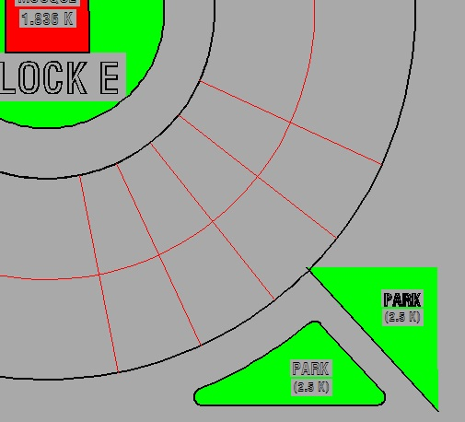
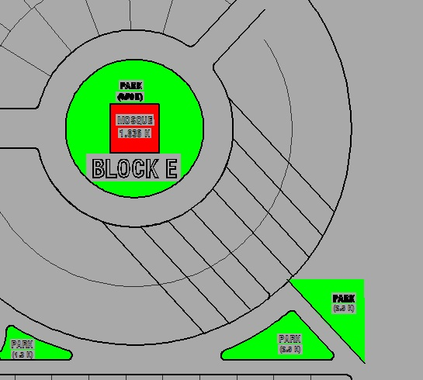
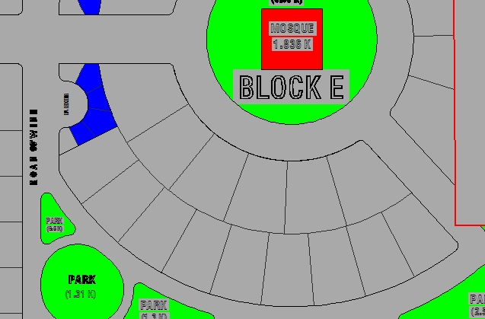
STEP-12 Cont…
IMPORTANT CONSIDERATIONS (Cont…)
Front should be at 90 angle to road.

Slide 43
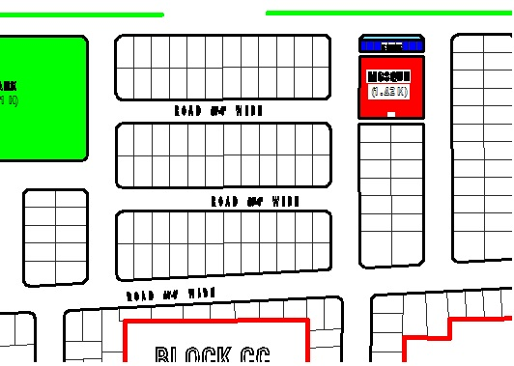
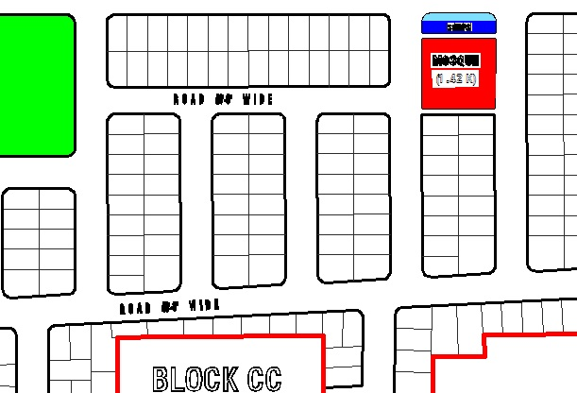
STEP-12 Cont…
IMPORTANT CONSIDERATIONS (Cont…)
How to deal with boundary?

Slide 44
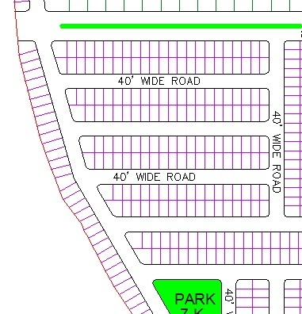
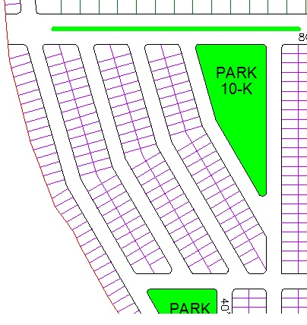
STEP-12 Cont…
IMPORTANT CONSIDERATIONS (Cont…)
How to deal with boundary?

Slide 45
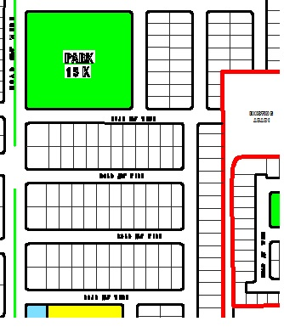
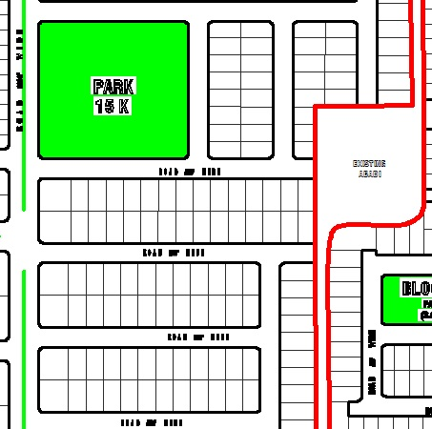
STEP-12 Cont…
IMPORTANT CONSIDERATIONS (Cont…)
Act smartly.

Slide 46
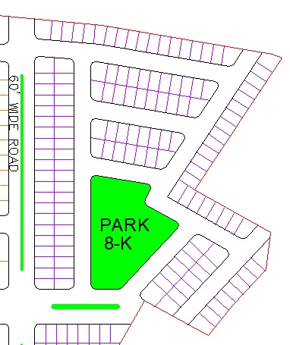
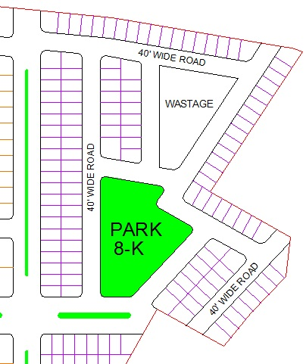
STEP-12 Cont…
IMPORTANT CONSIDERATIONS (Cont…)
Avoid extra wastage

Slide 47
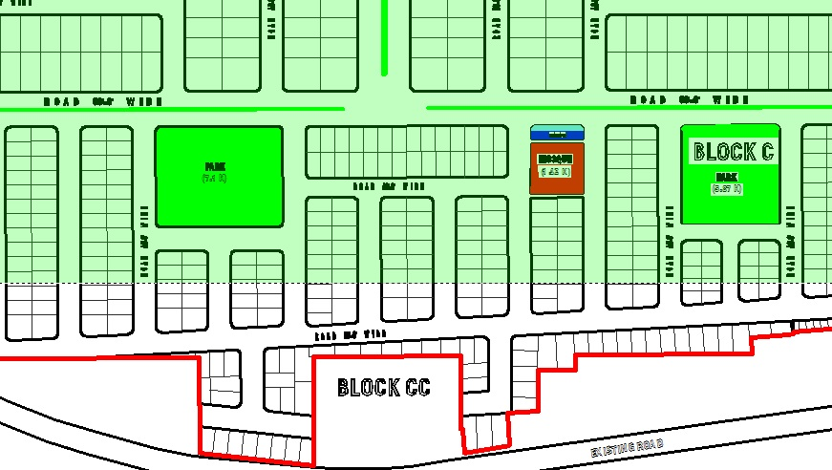
STEP-12 Cont…
IMPORTANT CONSIDERATIONS (Cont…)
Create regular plots as many as you can.

Slide 48
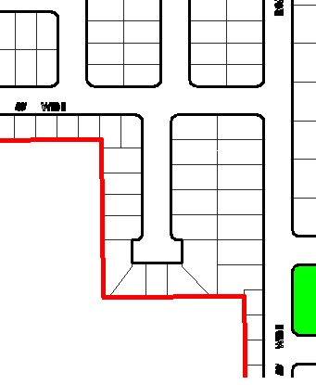
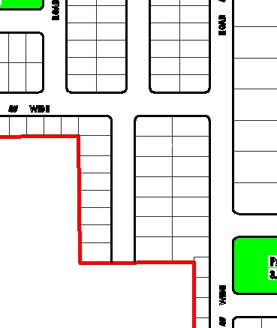
STEP-12 Cont…
IMPORTANT CONSIDERATIONS (Cont…)
Never compromise on quality.

Slide 49
STEP-12 Cont…
IMPORTANT CONSIDERATIONS (Cont…)
For small size plots sufficient road width.

Slide 50
STEP-12 Cont…
IMPORTANT CONSIDERATIONS (Cont…)
Avoid unnecessary opening on main roads.

Slide 51
STEP-12 Cont…
IMPORTANT CONSIDERATIONS (Cont…)

Slide 52
STEP-12 Cont…
IMPORTANT CONSIDERATIONS (Cont…)

Slide 53
STEP-12 Cont…
IMPORTANT CONSIDERATIONS (Cont…)
Standard size of plots

Slide 54
STEP-12 Cont…
IMPORTANT CONSIDERATIONS (Cont…)
Chamfer

Slide 55
STEP-12 Cont…
IMPORTANT CONSIDERATIONS (Cont…)
Plot numbering.

Slide 56
LAND USE DISTRIBUTION AND NEIGHBORHOOD PLANNING (Cont…)
STEP-12 Cont…
Neighborhoods self-sufficient
Accessibility and equally.
Eye on future extension.
Location of Commercial Centre

Slide 57
LAND USE DISTRIBUTION AND NEIGHBORHOOD PLANNING (Cont…)
STEP-12 Cont…
Neighborhoods self-sufficient
Accessibility and equally.
Eye on future extension.
Location of Commercial Centre

Slide 58
LAND USE DISTRIBUTION AND NEIGHBORHOOD PLANNING (Cont…)
STEP-12 Cont…

Slide 59
MAIN COMMERCIAL CENTRE
STEP-12 Cont…
The roads should have enough ROW to avoid traffic congestion.
Designated parking space.
Location should be appropriate to cater not only residents of scheme but also outsiders as well.
Design should be attractive one.

Slide 60
PLOTTING
STEP-13
Before earlier discussed steps should be in mind.
Try to produce standards side plot as many as you can.
Make a separate layer for each category of plot, land use, roads, centre line, regions, etc.
You must be expert in AutoCAD to save time. Memorize short keys for different commands in your min.
Learn working in Model and Layout.

Slide 61
PRODUCING MASTER PLAN
STEP-14
Have a detailed over view.
Check each block is self sufficient or have access to basic facilities.

Slide 62
PRODUCING MASTER PLAN (Cont…)
STEP-14 Cont…

Slide 63
PRODUCING MASTER PLAN (Cont…)
STEP-14 Cont…

Slide 64
CALCULATING AREA & LAND USE RULES
STEP-15
Create regions
Layiso
Massprop

Slide 65
CALCULATING AREA & LAND USE RULES (Cont…)
STEP-15 Cont…

Slide 66
SUBMISSION DRAWINGS
STEP-16
Master Plan
(Signed by Owner and Town Planner)
Master Plan super-imposed on Khasra Plan.
(Signed by Owner and Town Planner and Patwari and Tehsildar
Khasra Plan
(Signed by Owner, Patwari and Tehsildar)
Survey Plan
(Signed by Owner and Town Planner and Surveyor)
Location Plan
(Signed by Owner and Town Planner)

Slide 67
MASTER PLAN
STEP-16 Cont…

Slide 68
MASTER PLAN WITH IMPOSED KHASRA PLAN
STEP-16 Cont…

Slide 69
KHASRA PLAN
STEP-16 Cont…

Slide 70
LOCATION PLAN
STEP-16 Cont…

Slide 71
SURVEY PLAN
STEP-16 Cont…

Slide 72
MORTGAGE DETAILS
STEP-16 Cont…

Slide 73
PLOT STATEMENT
STEP-16 Cont…

Slide 74
LIST OF KHASRA NOs.
STEP-16 Cont…

Slide 75
I.B. HOUSING SOCIETY

Slide 76
NFC EMPLOYEES CO-OPERATIVE HOUSING SOCIETY

Slide 77
P & D DEPT. EMPLOYEES CO-OPERATIVE HS P-II, LAHORE

Slide 78
ZARAJ HOUSING ZONE-V ISLAMABAD

